Slide 1
201812
Tungsten Tip Etching
Lee Jong Geon

Slide 2
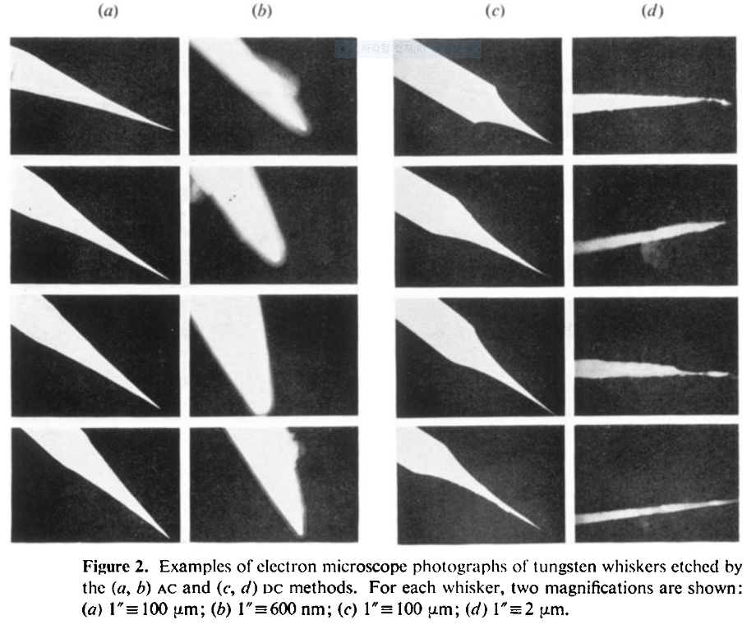
1978-J. Phys. D: Appl. Phys.-11-A comparison of AC and DC electrochemical etching techniques for the fabrication of tungsten whiskers (G. J. Edwards and P. R. Pearce)
AC
DC

Slide 3
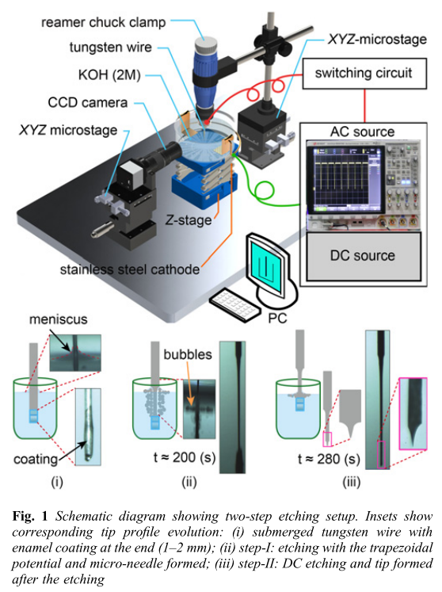
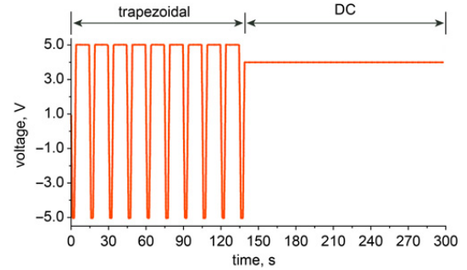
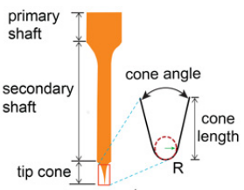
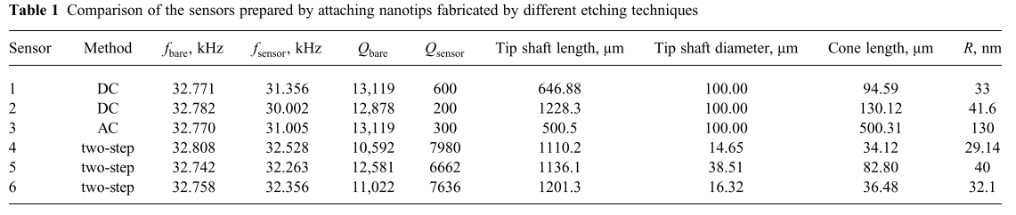
2018-Micro&Nano Letters-13,8-Electrochemical etching of lightweight nanotips for high quality-factor quartz tuning fork force sensor: atomic force microscopy applications (Danish Hussain, Jianmin Song, Hao Zhang, Xianghe meng and Hui Xie)

Slide 4
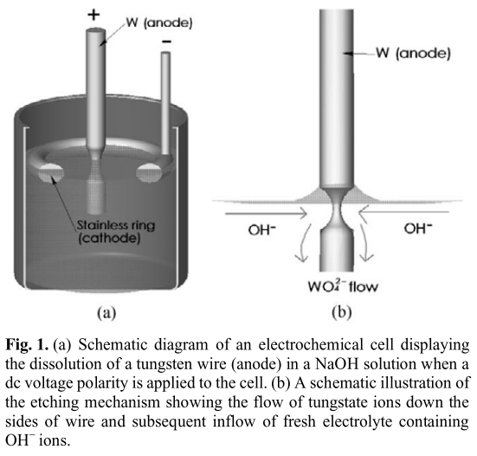
2003-Metals and Materials International-9,4-An Electrochemical Etching Procedure for Fabricating Scanning Tunneling Microscopy and Atom-Probe Field-Ion Microscopy Tips (Yeong-Cheol Kim and David N. Seidman)

Slide 5
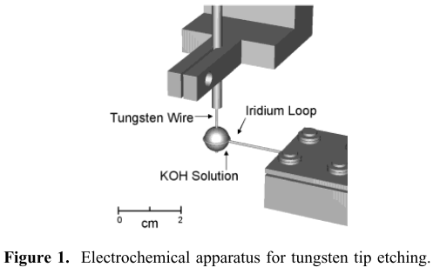
2002-Nano Letters-2,3-Reproducible Electrochemical Etching of Tungsten Probe Tips (Olivier L. Guise, Joachim W. Ahner, Moon-Chul Jung, Peter C. Goughnour, and John T. Yates, Jr.)

Slide 6
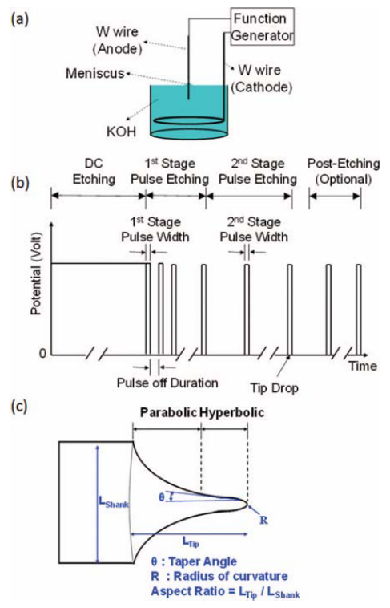
Tungsten Tip Etching
2012-Rev. Sci. Instrum.-83,08374-Method of electrochemical etching of tungsten tips with controllable profiles(Wei-Tse Chang, Ing-Shouh Hwang, Mu-Tung Chang, Chung-Yueh Lin, Wei-Hao Hsu and Jin-Long Hou)
AFG-3051, GW Instek, Taiwan
10M KOH – reduce time, meniscus stable
Parameter: DC potential, Duration, Pulse width (1st, 2nd), number of post-etching pulses
1st pulse off duration: 100 ms
2nd pulse off duration: “a longer time, say 1 s, for human response turn off the pulses right after the lower part of the wire breaks off.”
Post-Etching pulse width: 1 ms

Slide 7
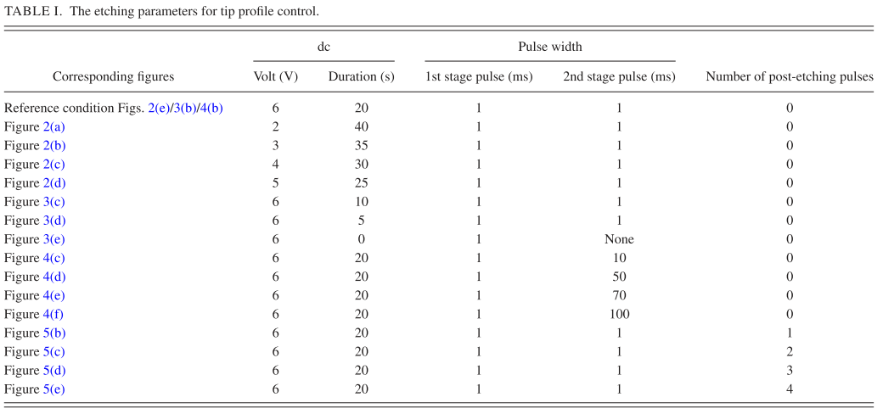
Tungsten Tip Etching
2012-Rev. Sci. Instrum.-83,08374-Method of electrochemical etching of tungsten tips with controllable profiles(Wei-Tse Chang, Ing-Shouh Hwang, Mu-Tung Chang, Chung-Yueh Lin, Wei-Hao Hsu and Jin-Long Hou)
DC potential
DC duration
2nd
pulse width
# of
post-etching

Slide 8
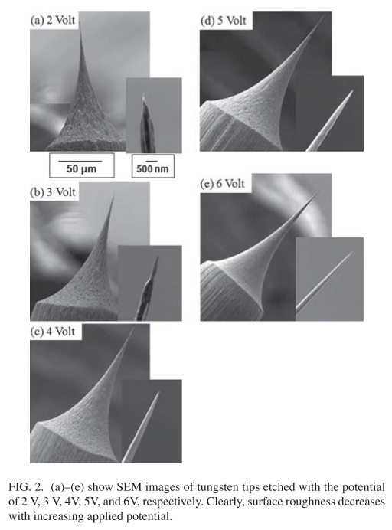
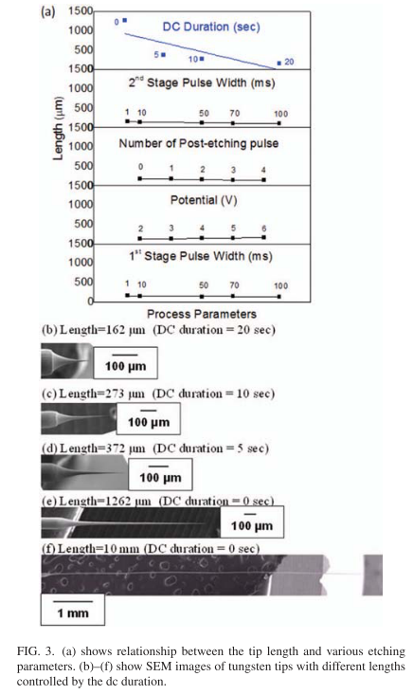
Tungsten Tip Etching
Surface roughness
2012-Rev. Sci. Instrum.-83,08374-Method of electrochemical etching of tungsten tips with controllable profiles(Wei-Tse Chang, Ing-Shouh Hwang, Mu-Tung Chang, Chung-Yueh Lin, Wei-Hao Hsu and Jin-Long Hou)

Slide 9
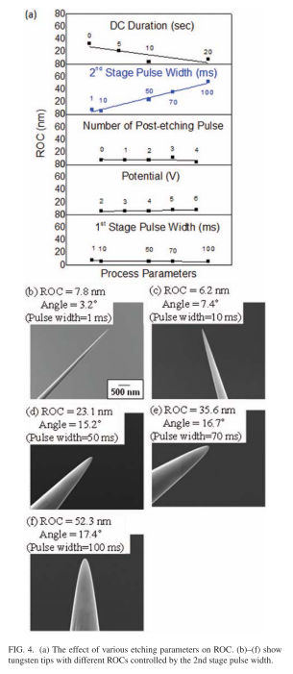
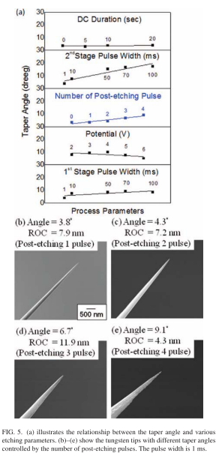
Tungsten Tip Etching
2012-Rev. Sci. Instrum.-83,08374-Method of electrochemical etching of tungsten tips with controllable profiles(Wei-Tse Chang, Ing-Shouh Hwang, Mu-Tung Chang, Chung-Yueh Lin, Wei-Hao Hsu and Jin-Long Hou)

Slide 10
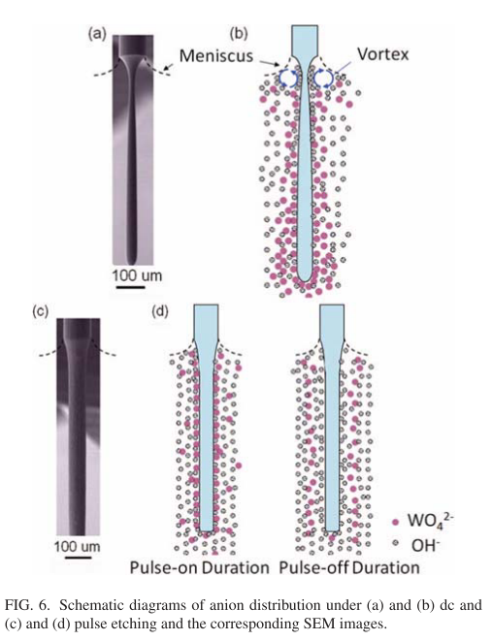
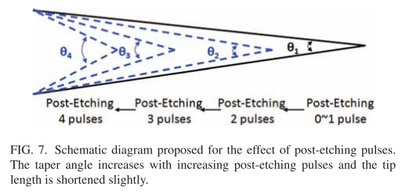
Tungsten Tip Etching
DC(uniform)
etching
Pulse
etching
2012-Rev. Sci. Instrum.-83,08374-Method of electrochemical etching of tungsten tips with controllable profiles(Wei-Tse Chang, Ing-Shouh Hwang, Mu-Tung Chang, Chung-Yueh Lin, Wei-Hao Hsu and Jin-Long Hou)

Slide 11
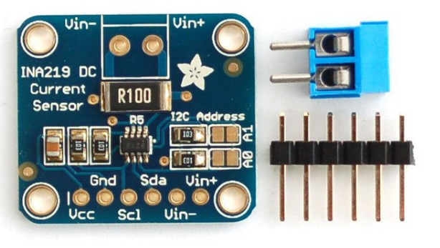
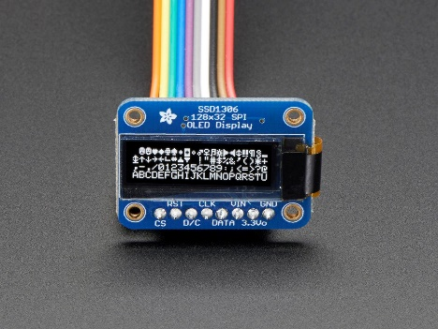
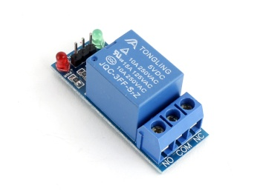
Hardware Design
Current Sensor: INA219 High Side DC Current Sensor Breakout
Max DC: 26 V
Max Current: ±3.2 A
Resolution: 0.1 mA
Precision: 1%
➔ 제조사에서 library 및 Arduino code 제공
Monitor display: Monochrome 128*32 SPI OLED graphic display
128*32 individual white OLED pixels
➔ 제조사에서 library 및 Arduino code 제공
Switch: Arduino 1 CH 5V relay module
Arduino에서 전류 ON/OFF control
https://learn.adafruit.com/adafruit-ina219-current-sensor-breakout/overview

